Slide 1

Demo Setup
Required OS
Ubuntu 18.04 / 20.04
WSL2
Install Qiling Framework, Human Way
pip3 install qiling
Install Qiling Framework, Hackers way
sudo apt-get update
sudo apt-get upgrade
sudo apt install python3-pip git cmake build-essential libtool-bin python3-dev automake flex bison libglib2.0-dev libpixman-1-dev clang python3-setuptools llvm
git clone https://github.com/qilingframework/qiling.git
cd qiling && sudo python3 setup.py
Fuzz
https://github.com/AFLplusplus/AFLplusplus/archive/2.66c.zip
cd AFLpulsplus
make binary-only
cd unicorn_mode
./build_unicorn_support.sh
https://github.com/kabeor/Temp.git

Slide 2
Prepare for Qiling IDA plugin
python3 –m venv qiling_env
source qiling_env/bin/activite
cd qiling.git
python –m pip –e .
﻿import sys
sys.path.append('/Users/home/Pipenv/qiling_run/lib/python3.7/site-packages')
sys.path.append('/Users/home/Documents/Codes/Python/qiling_dev/qiling')

Slide 3
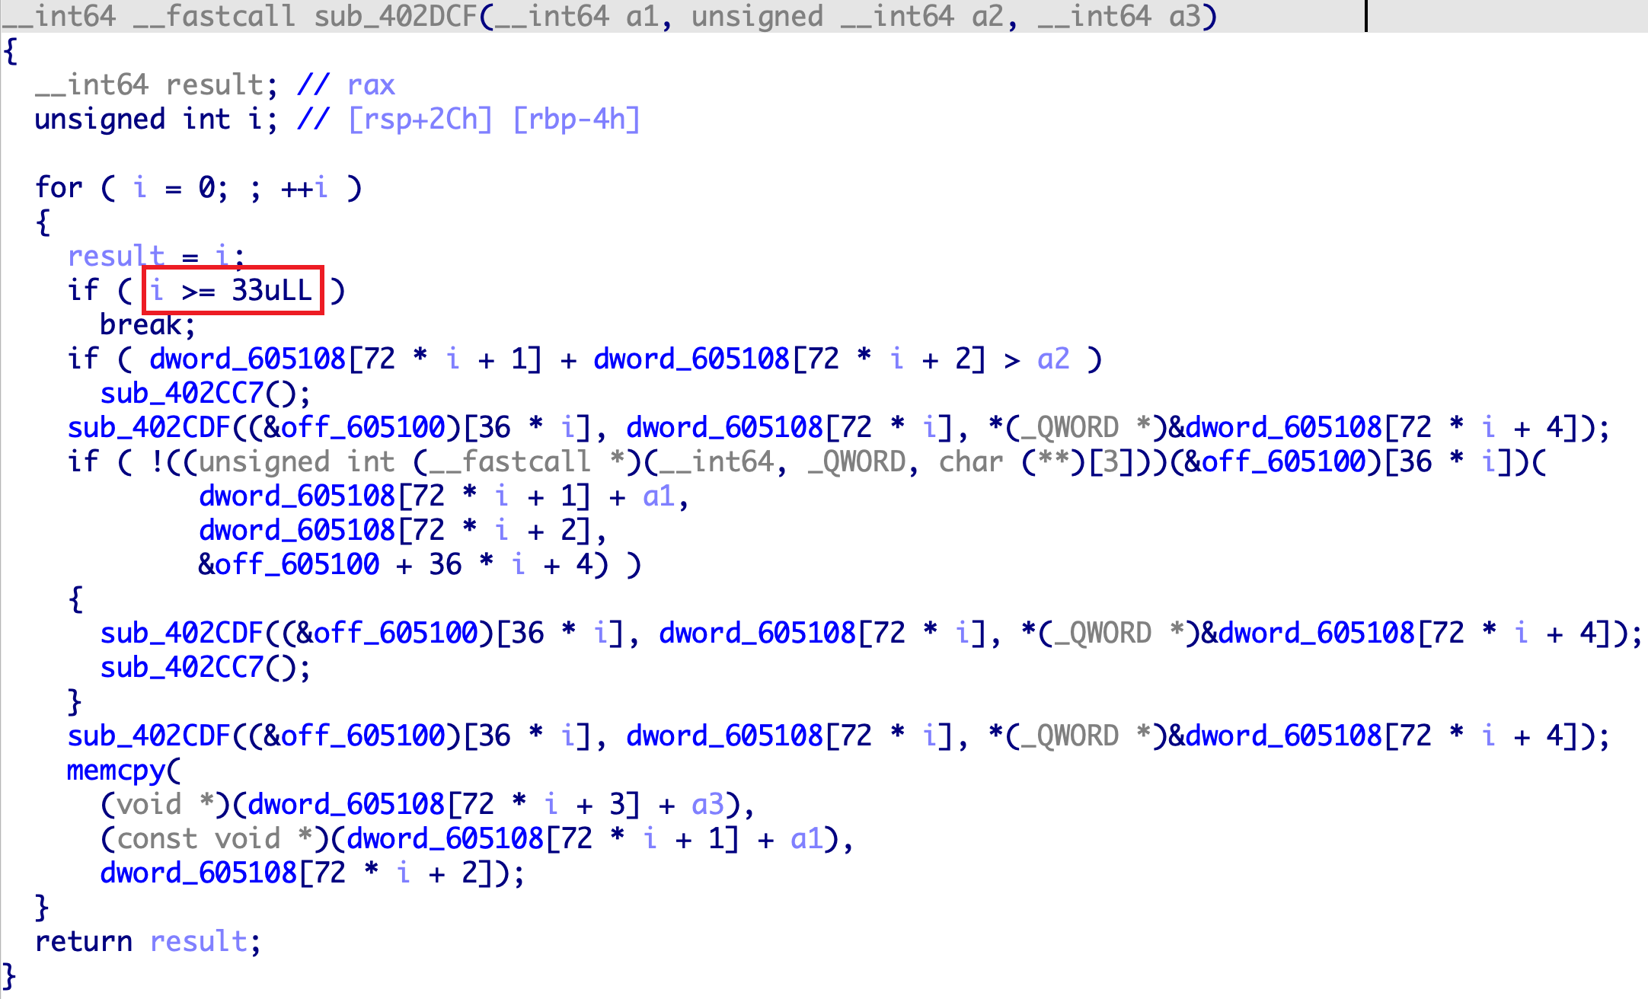
Sample Analysis
The validation function validates the user input in a loop.
In each iteration of the validation loop, a different part of the entered key is validated.

Slide 4
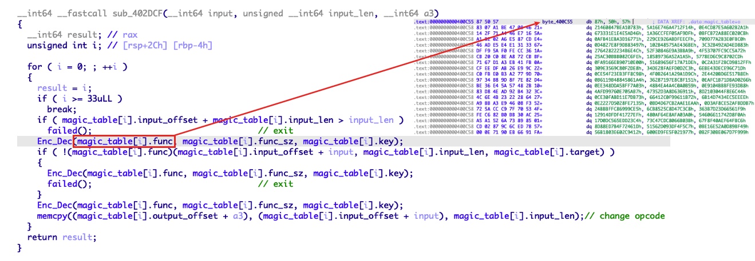
Sample Analysis
After analysis, it is found that the verification algorithm is stored in magic_table.
”magic_table” is encrypted but it will decrypt in memory in each iteration of the validation loop.
The verification algorithm will automatically change after each round of verification.

Slide 5
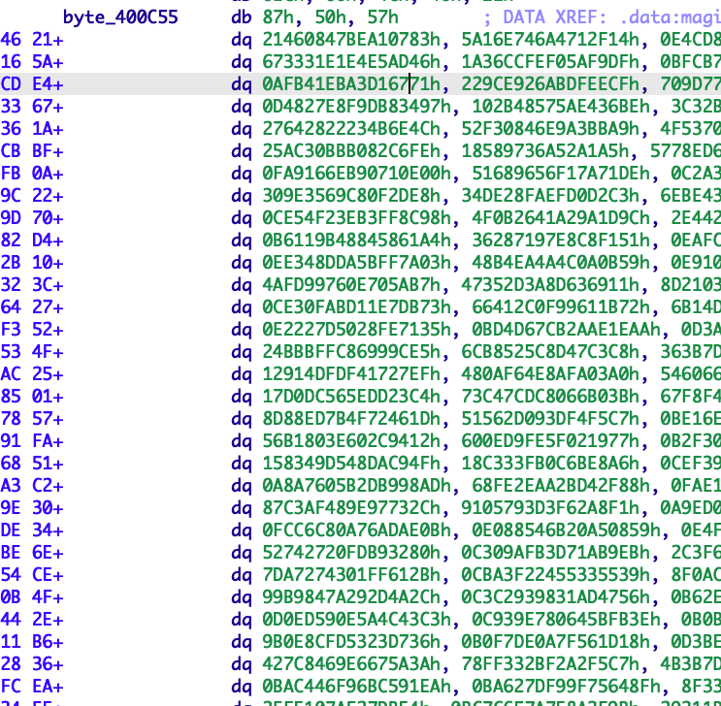
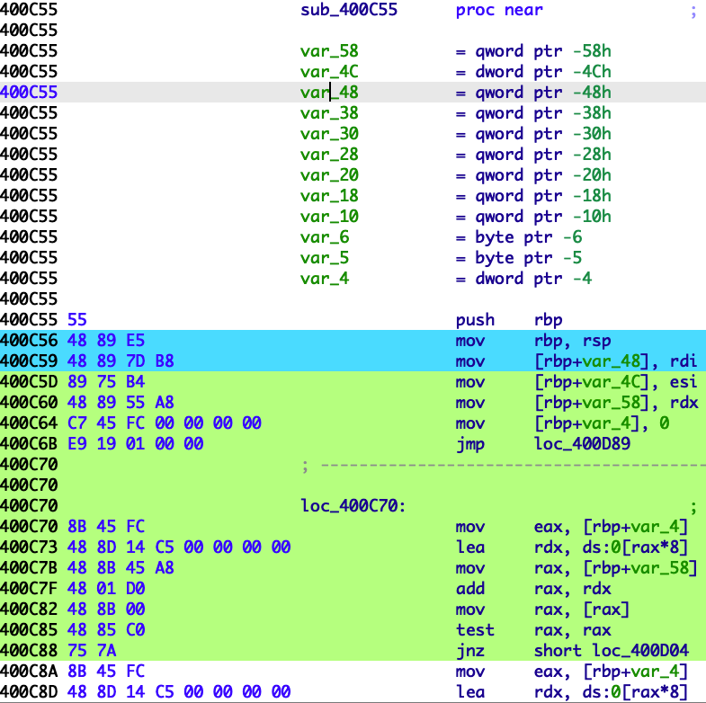
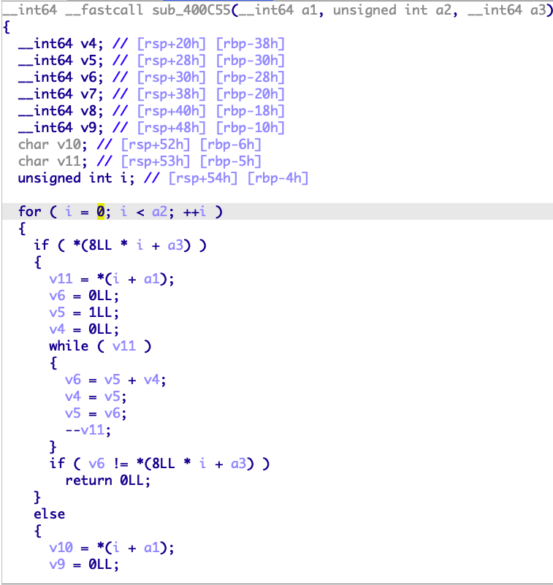
Sample Analysis
We will use qiling to:
emulate this challenge
decrypt magic_table
cover bytes to asm
Use IDA Pro Hex-Rays Decompiler to:
decompile the verification algorithm
Encrypted
Decrypted
Decompile

